Slide 1


SMART INDIA HACKATHON 2025
Problem Statement ID –SIH25092
Problem Statement Title-Development of a Digital Mental Health and Psychological Support System for Students in Higher Education
Theme-MedTech / BioTech / HealthTech
PS Category- Software
Team ID- 72748
Team Name - Debut hack

Slide 2
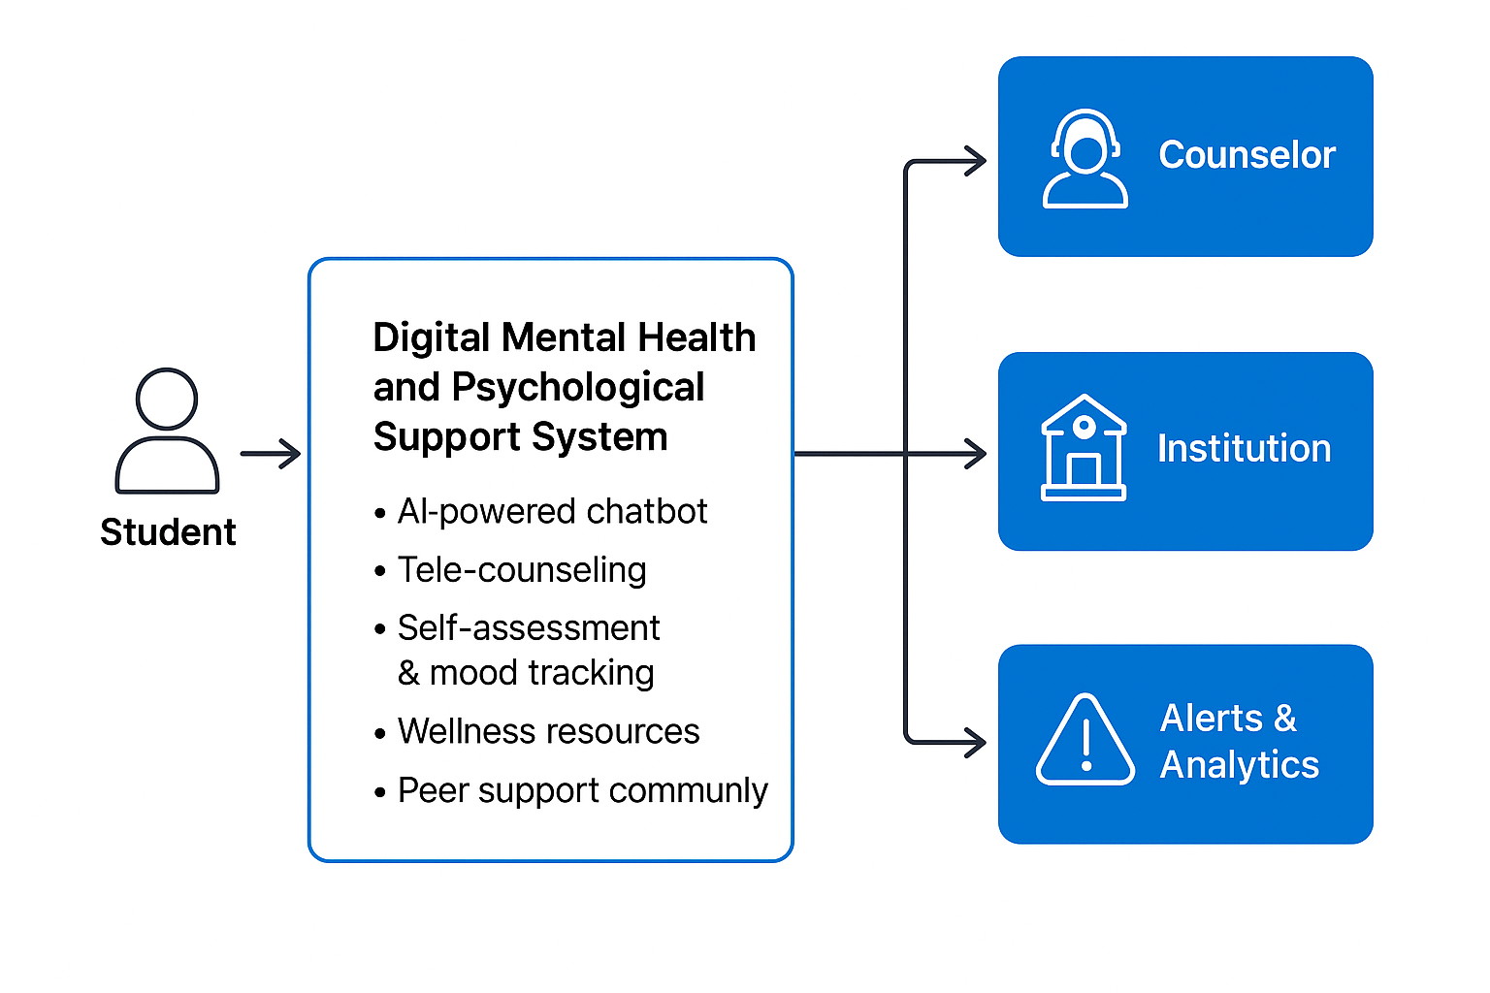
EduCare: A Digital Mental Health and Wellness Solution for University Students”
Debut hack
- The transition to higher education can be stressful, leading to anxiety, depression, and burnout.
This platform leverages AI, machine learning, and secure cloud technology to provide students with accessible, stigma-free mental health support
Key features of our website:
AI Chatbot: 24/7 emotional support and guidance.
Self-Help Tools: Mindfulness exercises, mood tracking, and stress management.
Tele-counseling: Secure video/audio sessions with licensed counselors.
Peer Support: Anonymous forums for shared experiences and resilience building.
Crisis Intervention: Alerts for high-risk situations.
Institutional Dashboard: Data insights to guide wellness initiatives

Slide 3
TECHNICAL APPROACH
Debut hack
Component | Highlight / Keywords
Architecture | Cloud-based, modular, scalable | ☁️
Front-End | Mobile + Web, multilingual, accessible UI | 📱 💻
Back-End | Node.js/Django, REST APIs, secure auth | 🖥️ 🔒
AI/ML | 24/7 Chatbot, sentiment analysis, coping tips | 🤖 💬
Counselor Support | Video/audio sessions, AI-moderated forums | 🎥 👥
Analytics | Dashboards, stress & engagement trends | 📊 📈
Integration | LMS & calendar sync | 🔗 📅
Data Security | GDPR, HIPAA, anonymized research data | 🛡️ 🔐
Deployment | CI/CD, Docker & Kubernetes, scalable & reliable | ⚙️ 🚀

Slide 4
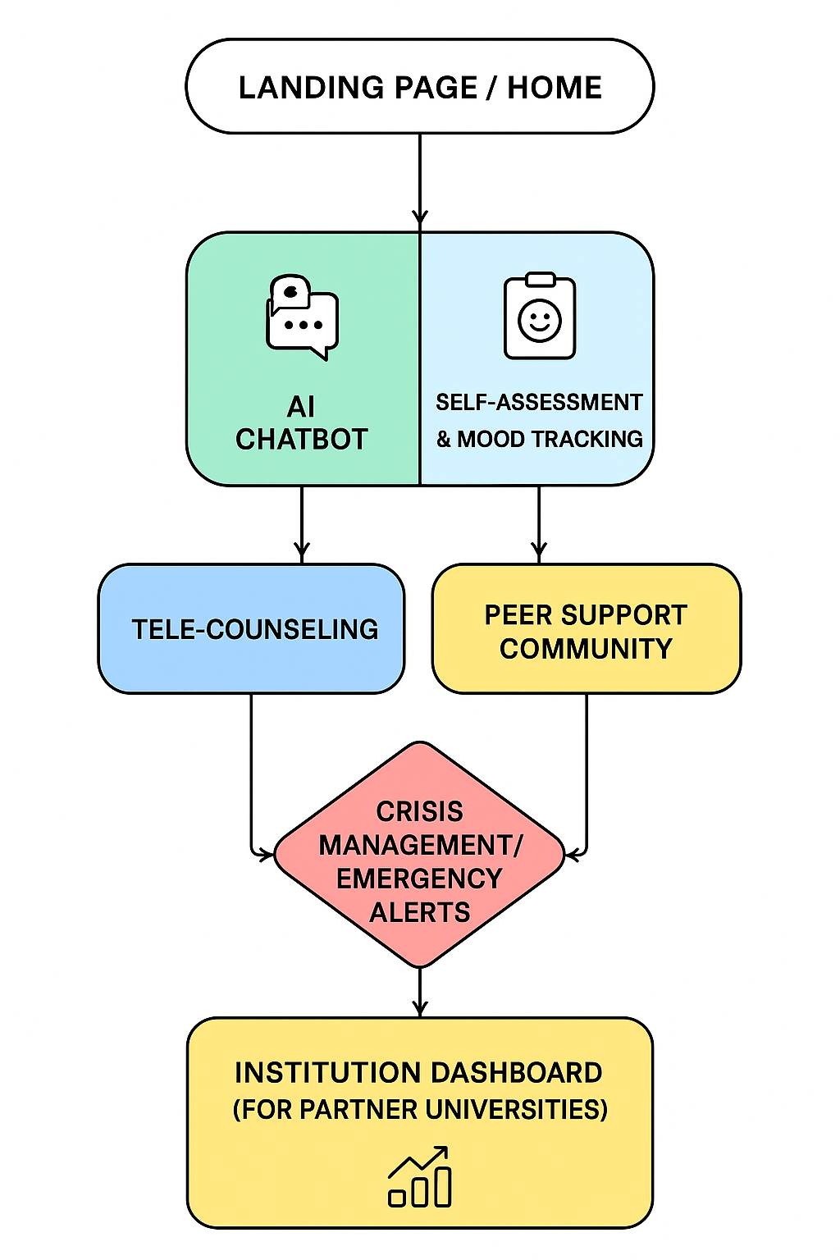
Debut hack

Slide 5
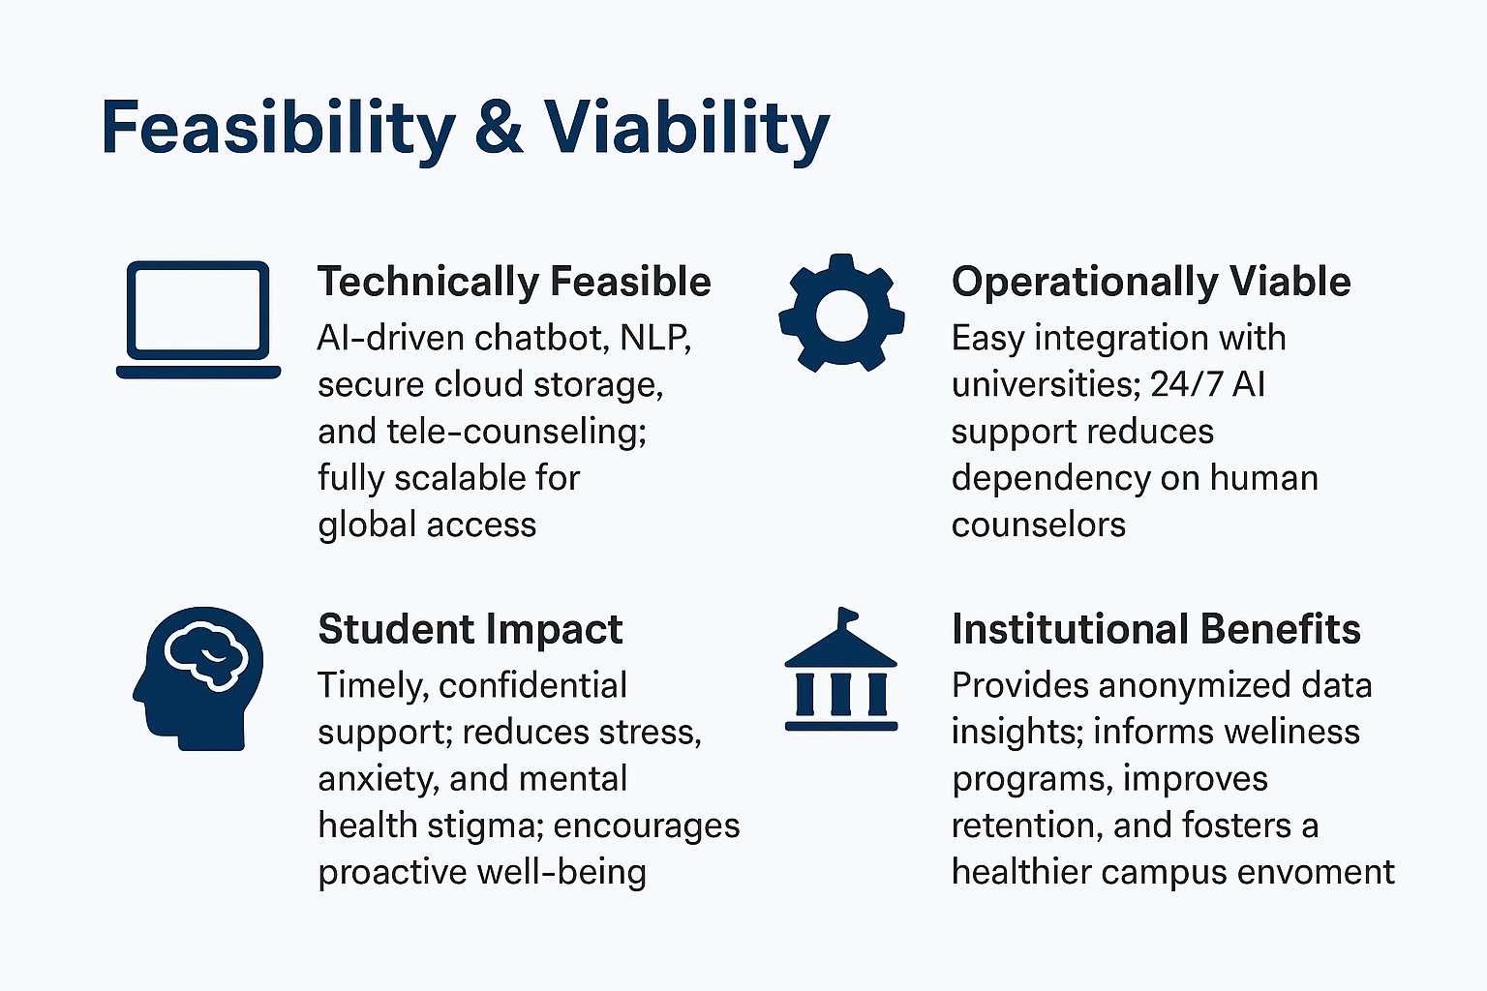
Debut hack

Slide 6
IMPACT AND BENEFITS and References
Debut hack
Category | Impact & Benefit
👩‍🎓 Students | Early stress detection, reduced stigma, safer environment ✅
🏫 Institutions | Data-driven insights, better engagement & lower dropout 📊
🌍 Society | Promotes mental well-being, reduces stigma 🧠
💻 Platform | 24/7 AI & tele-counseling, personalized guidance, gamified & secure ⏰🔒🎯
References
World Health Organization. (2021). Mental health of students in higher education. https://www.who.int
National Institute of Mental Health. (2020). College students and mental health. https://www.nimh.nih.gov
Fitzpatrick, K. K., Darcy, A., & Vierhile, M. (2017). Automated conversational agent for young adult mental health. JMIR Mental Health, 4(2), e19.
Inkster, B., Sarda, S., & Subramanian, V. (2018). Empathy-driven AI agent for mental health. Digital Health, 4.
GDPR. (2018). Regulation (EU) 2016/679. https://gdpr-info.eu

